Slide 1
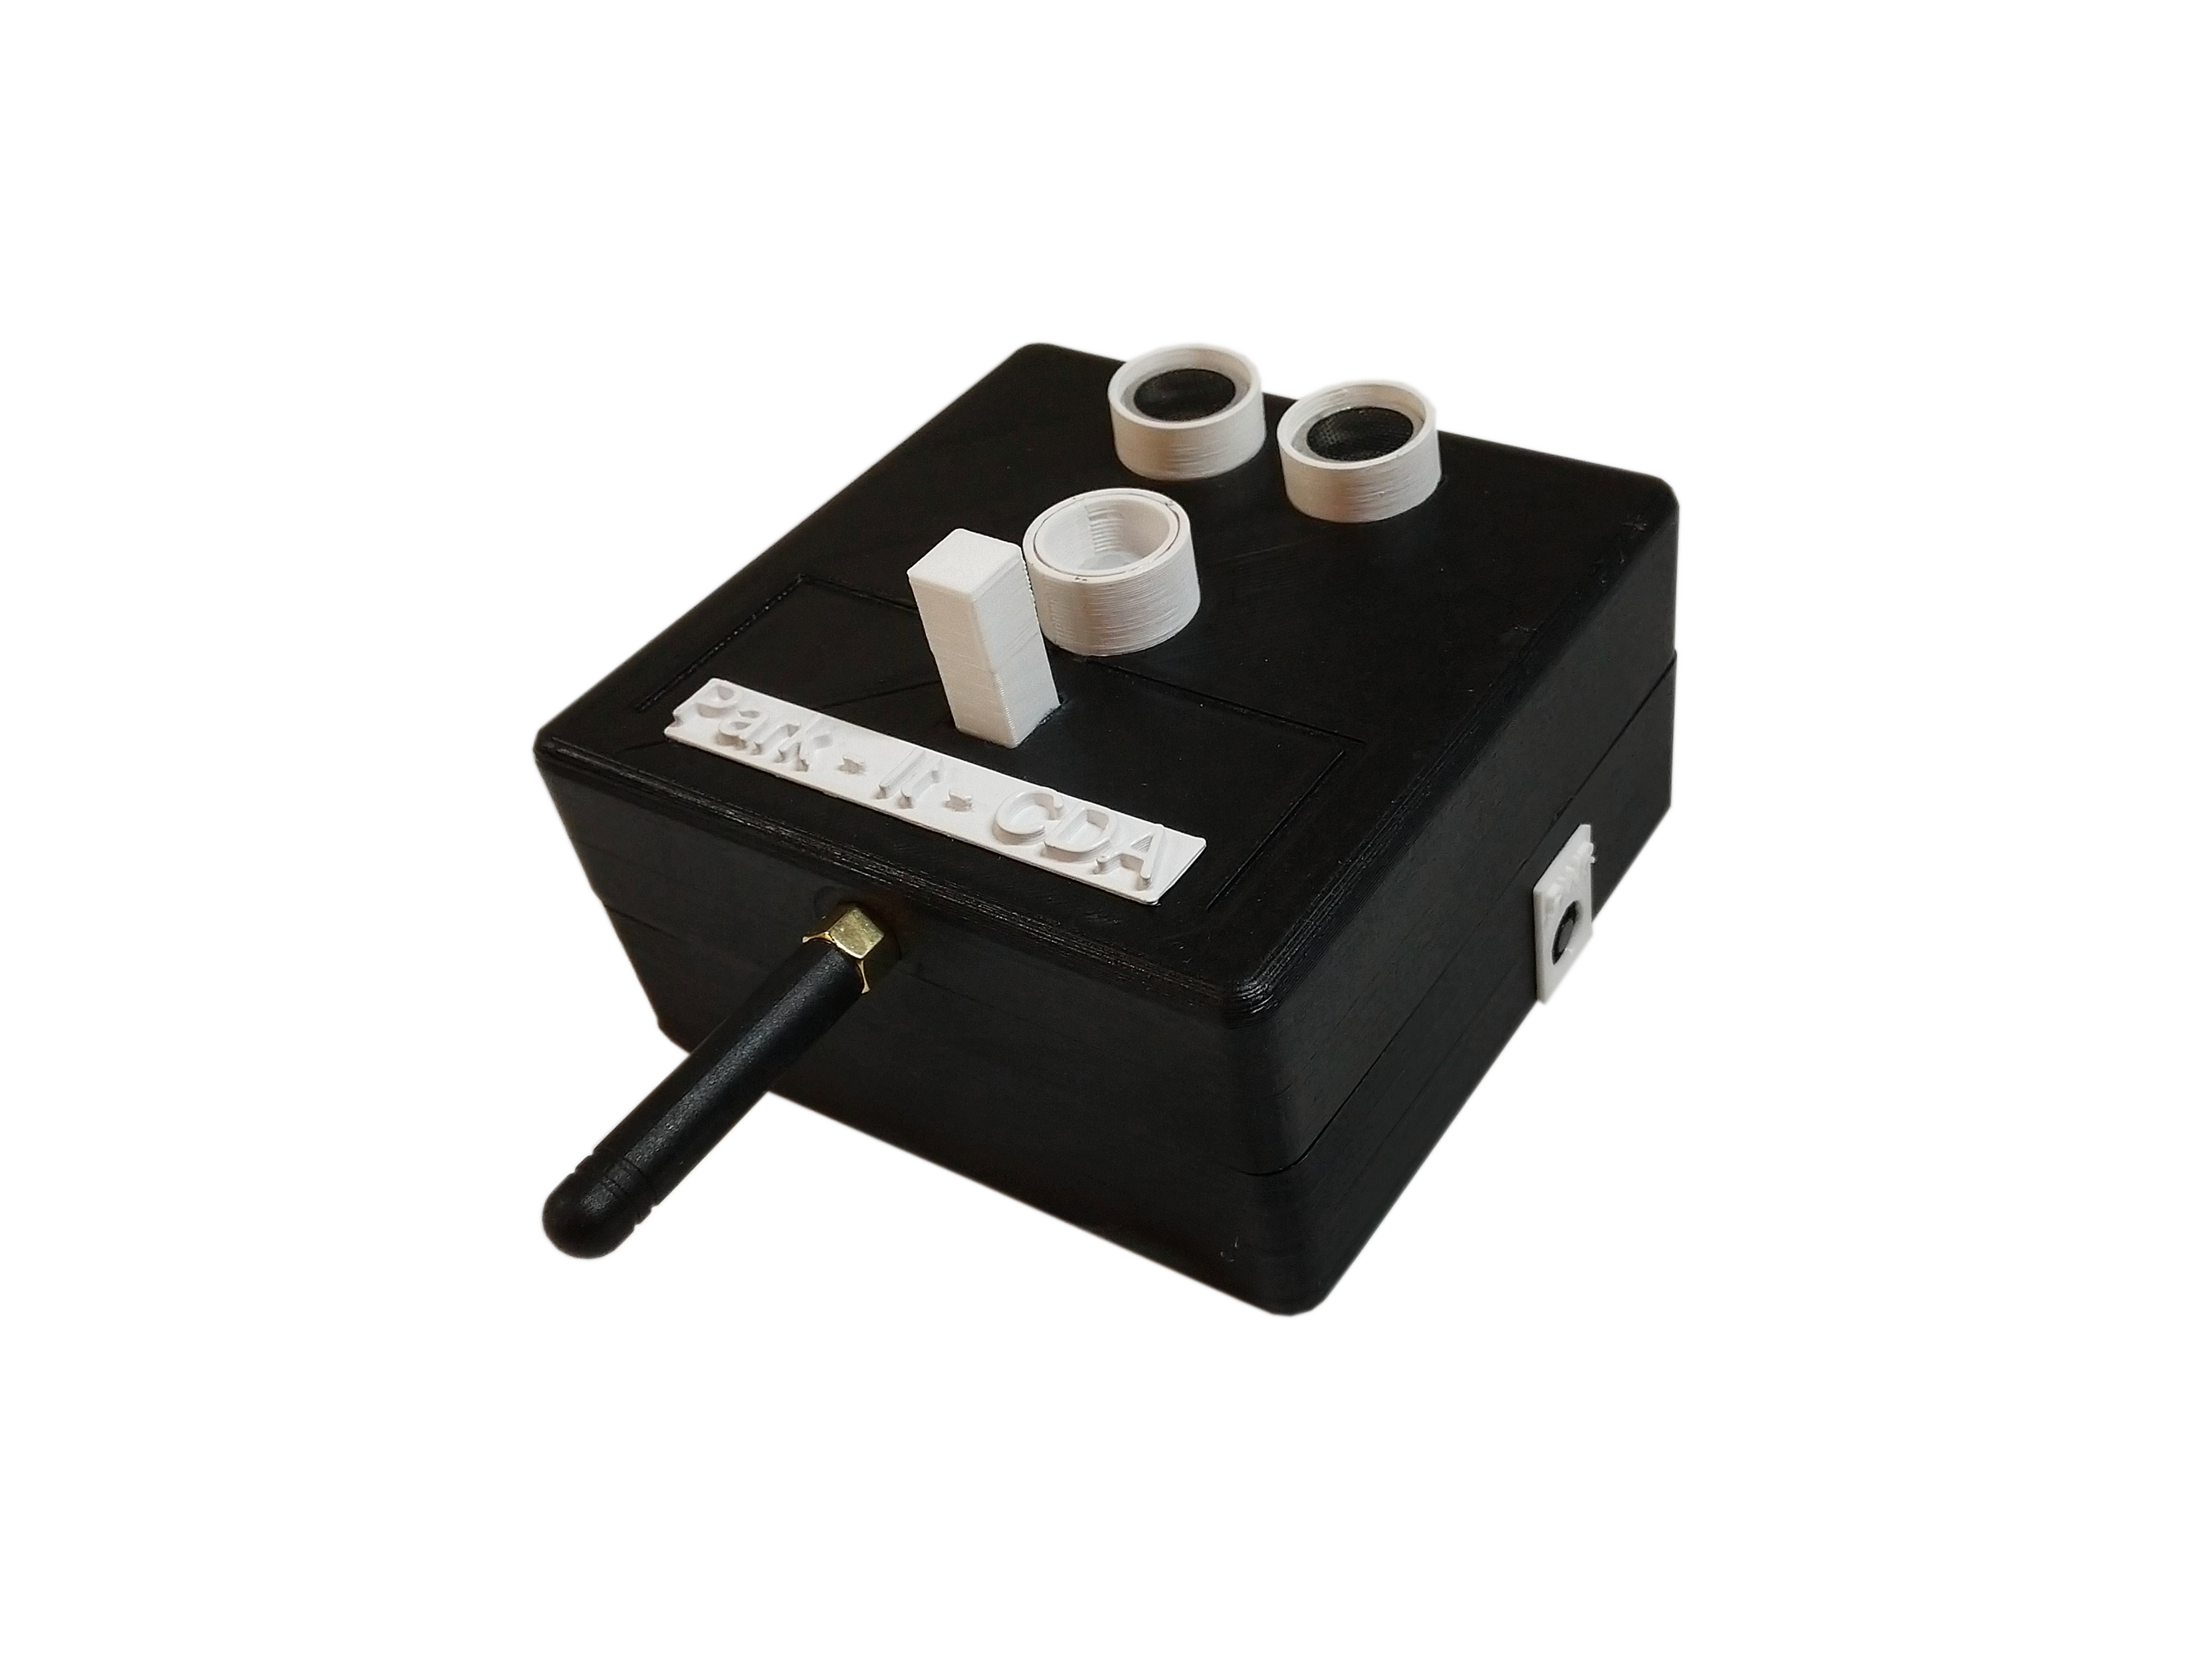
Park – It - Cda
A Garage sensor system over a mesh network

Slide 2

Park – it - cda
Team members and roles
Nikolai Tiong
Tyrel Parker
Team leader
Mesh network
Simulation
Database
Zane Goodrick
Joel Berain
Unit Design
Sensor Prototyping
Encryption
Wiki Site

Slide 3
Value proposition
The problem
Too much time and effort are being spent by those looking for a place to park in one or more garages in downtown Coeur d’ Alene.
Our solution
A parking indication system
Vehicle sensing over stalls
LED indication to commuters
Mesh networking via detection/indication units
A dynamic companion webpage to monitor/simulate entire garage

Slide 4
Objective and deliverables
Our goal
Outfit the parking garage in downtown CDA with 5 prototype units
Build a mesh network for units to relay stall status to a gateway at the Innovation Den
Build a simulation to show what a full-garage deployment would look like

Slide 5
Requirements
Optional features
The units | The mesh network | The simulation
 |  | Expandable for future projects
The units | The mesh network | The simulation
 | Units can choose a master and slave dynamically to save on battery | Graphical representation of system
lasts at least a year via battery power | Encryption of data | Companion app for phone/tablet
Security camera-like appearance for theft/tamper prevention |  | Data collection
Enclosure no larger than 4” X 4” X 4”
Units relay messages to gateway at the den
representation of a full garage deployment
Redundancies of sensors for better accuracy
Sensors to detect presence of vehicles in stall
Data maintains integrity and authentication
Real time updates of stall status
LED to indicate stall status to commuters
Units are provisioned
Populated with accurate test data
Units synchronized and can communicate for message routing

Slide 6
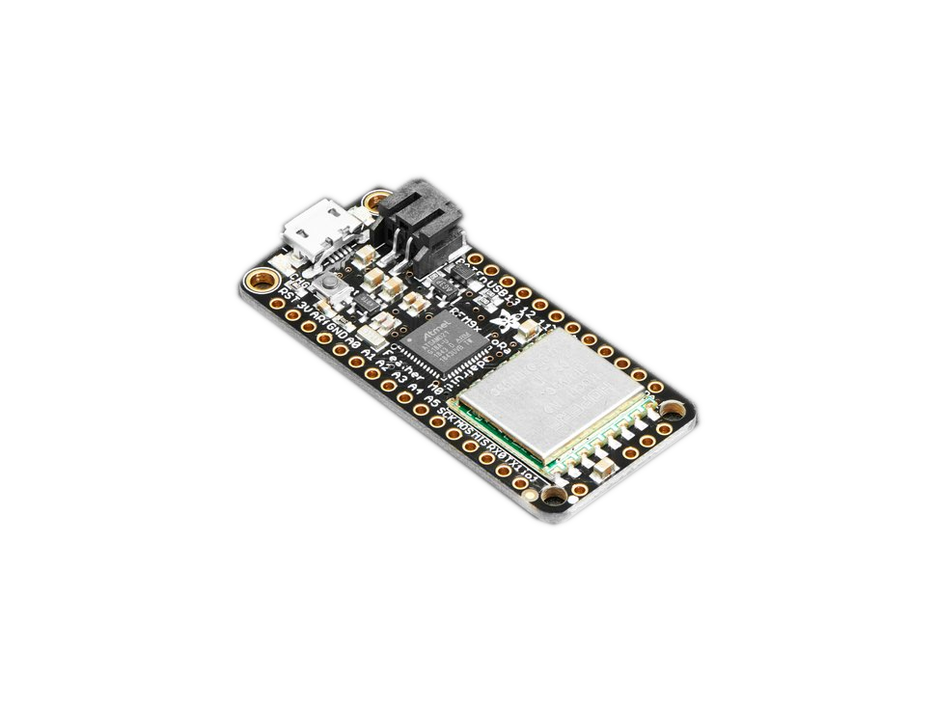
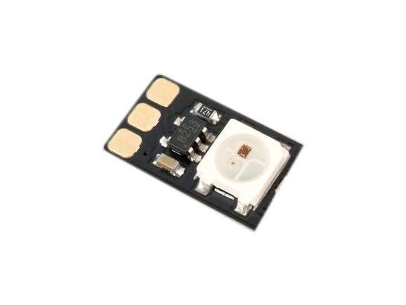
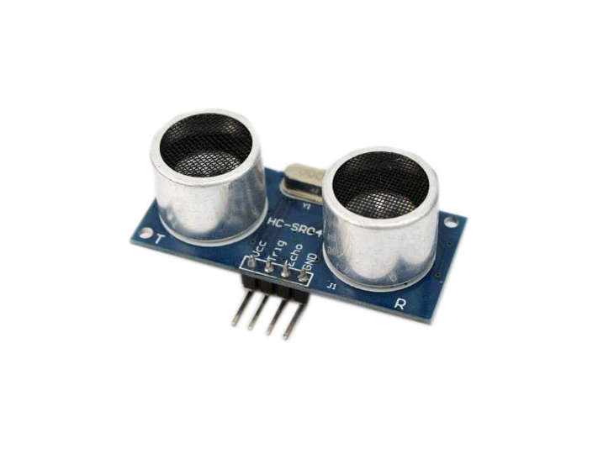
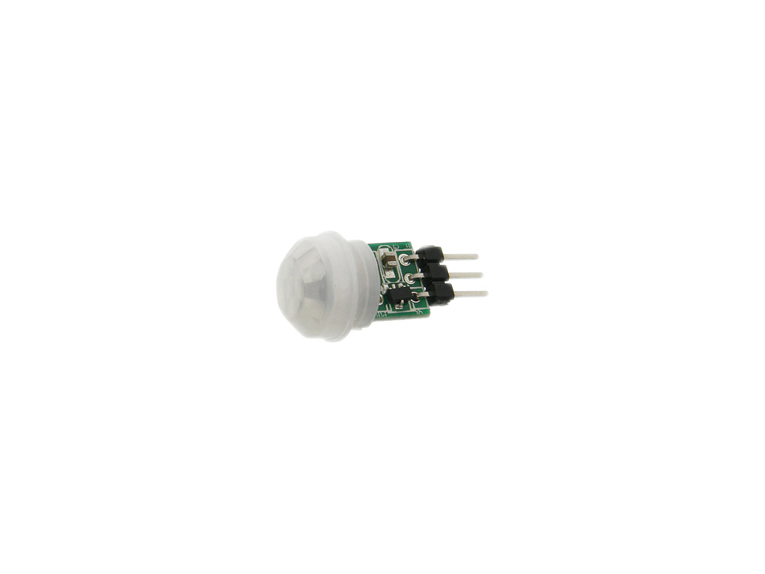
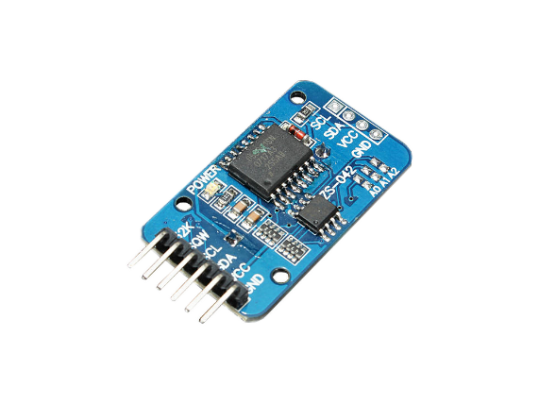
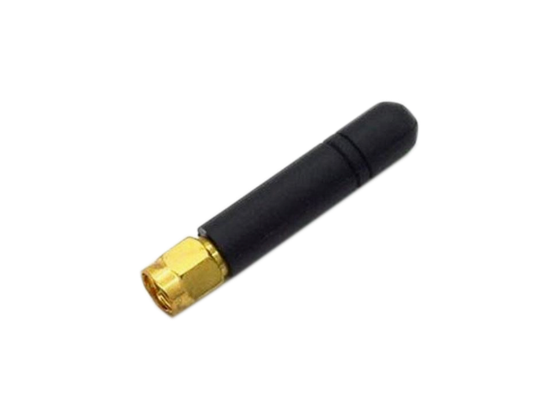
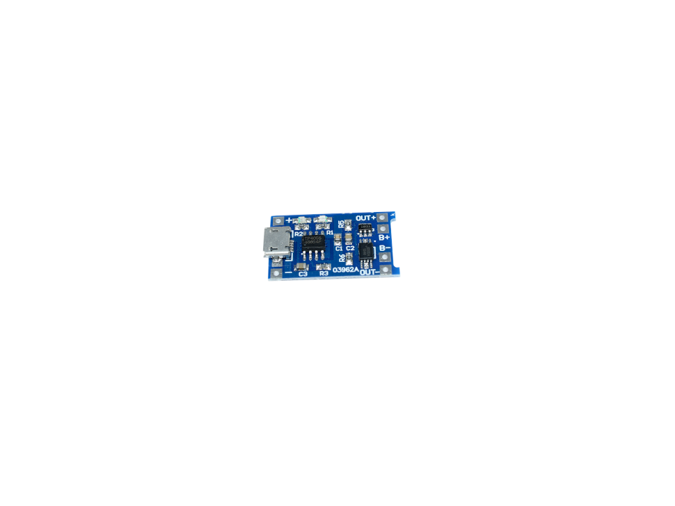
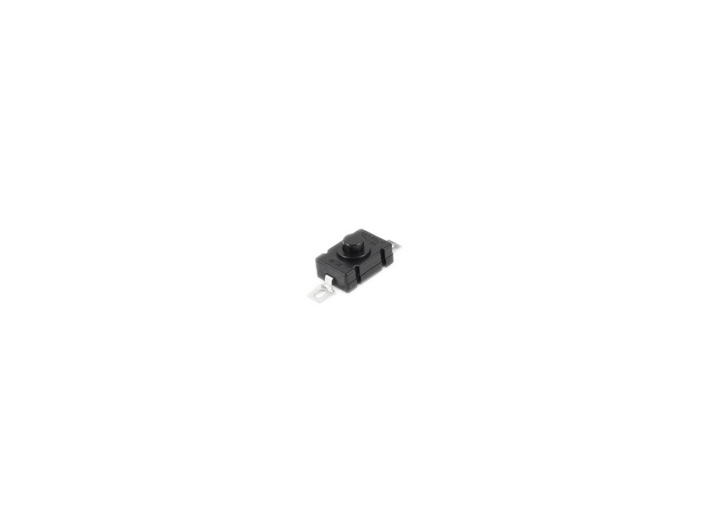
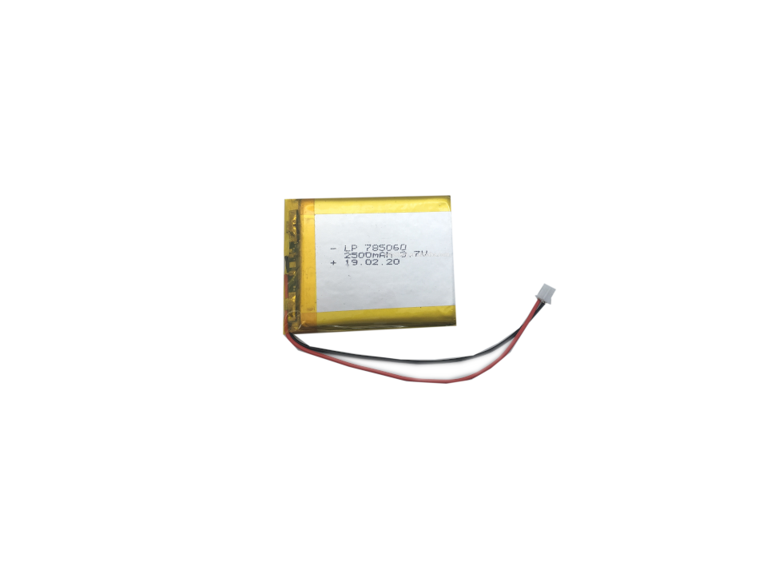
Components
The hardware
The Sensors
The Microcontroller
Other Components
Adafruit Feather M0 LoRa
RGB LED
HC-SR04 Ultrasonic Sensor
Real-Time Clock
AM312 PIR Sensor
LoRa Antenna
Power
2500mah Lipo Battery
Lipo Charger
Latching Power Switch

Slide 7
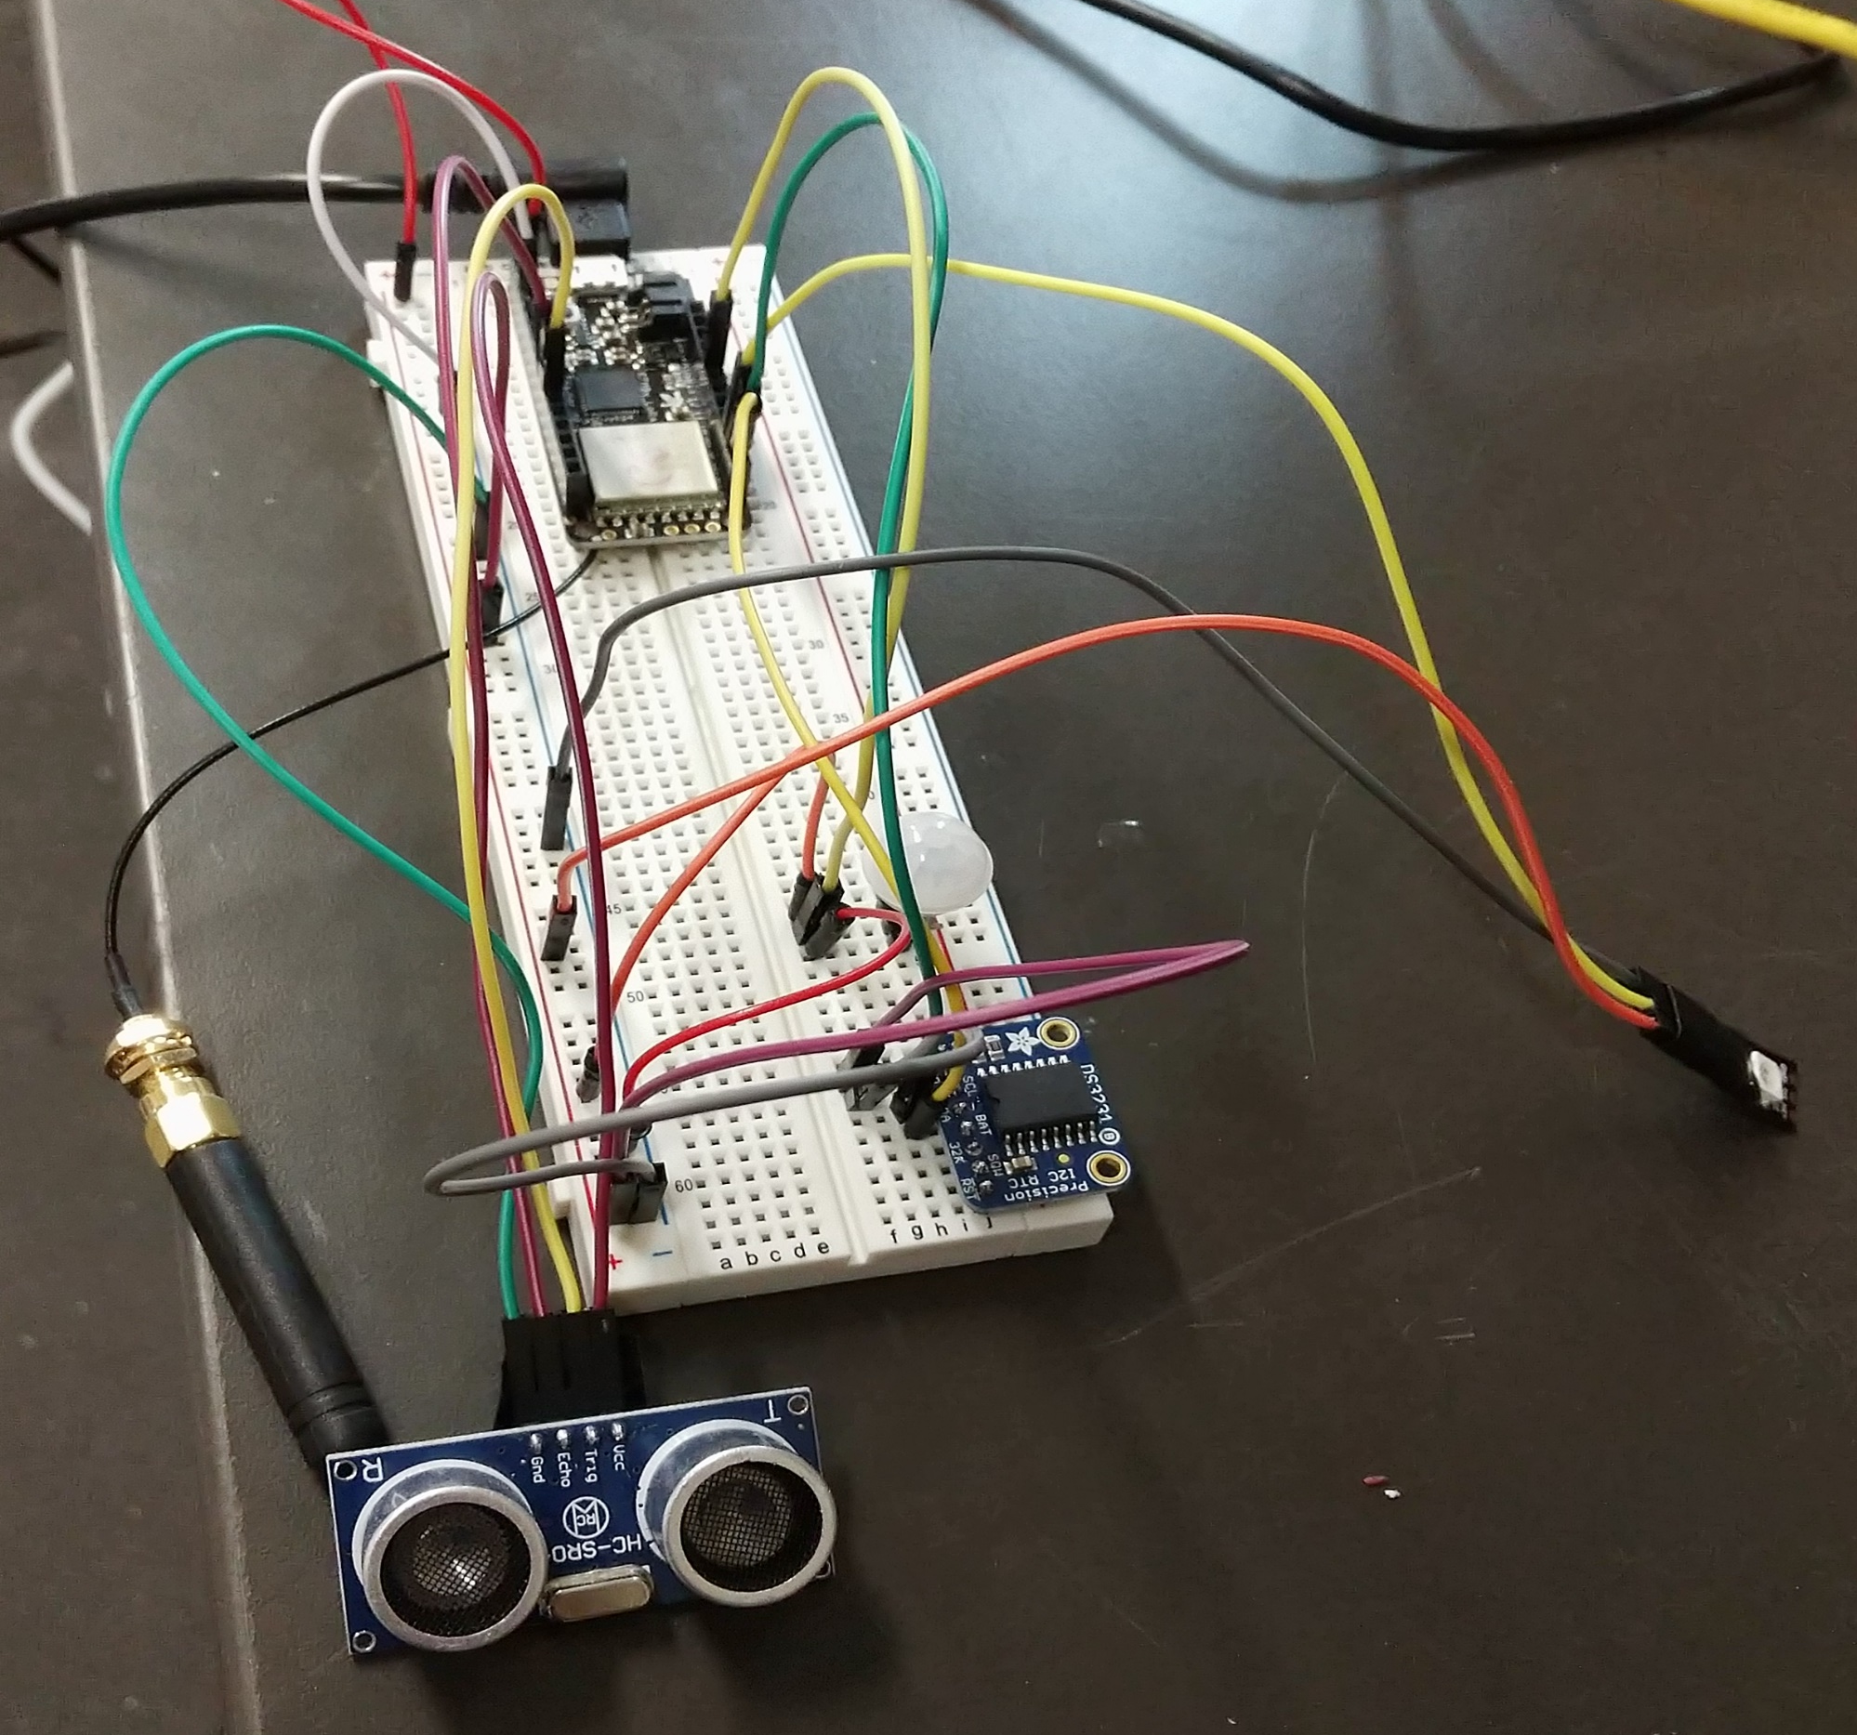
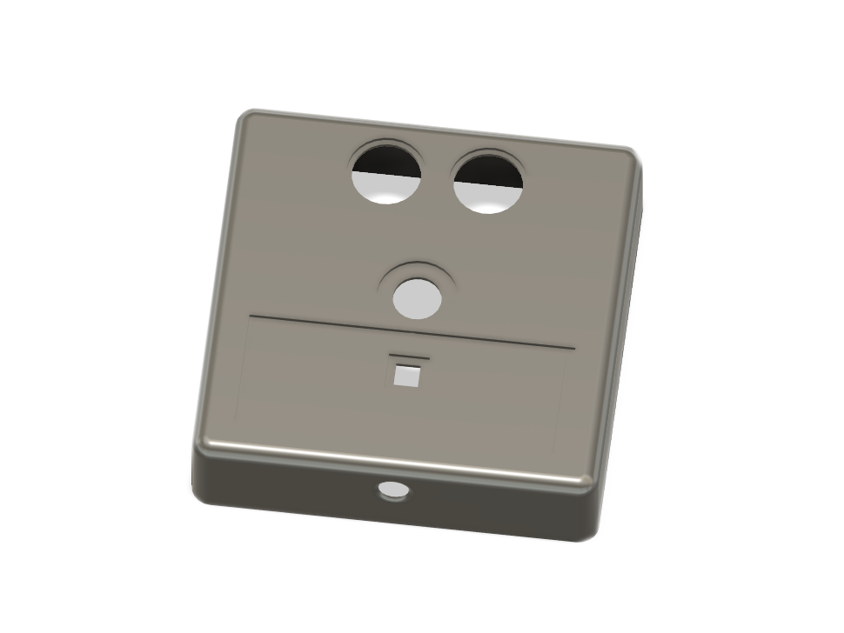
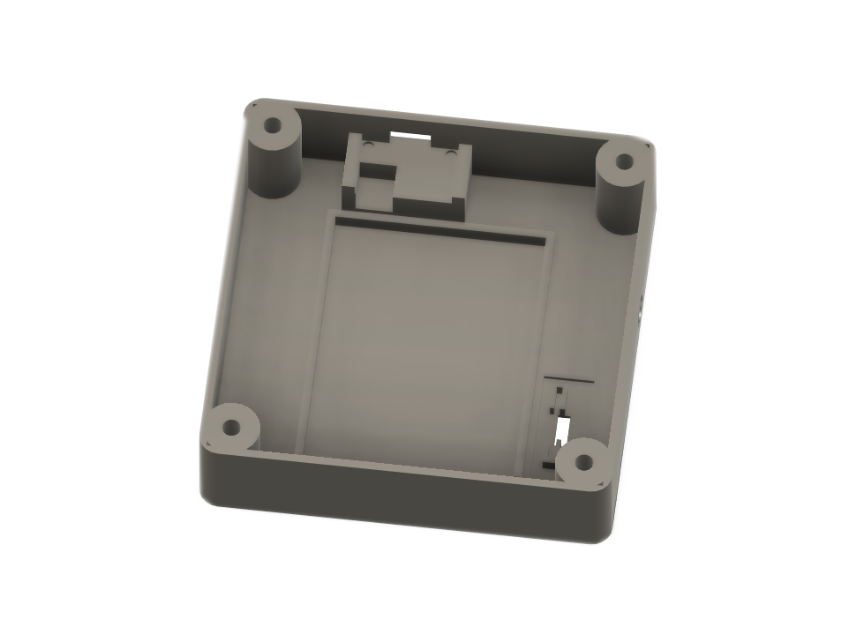
The Enclosure
Prototyping, Designing and assembling
Feather M0 w/LoRa
Designing the enclosure
PIR sensor
RGB LED
Real-time clock
LoRa antenna
Ultrasonic distance sensor
Final enclosure design created in Fusion360
Breadboard assembly

Slide 8
Completed prototype
- The ultrasonic sensor reads the distance to the ground 3 times to see if there is a blockage in the stall, outlying distances are thrown out in a 2 – to – 1 vote
- The PIR motion sensor wakes up the CPU via external interrupt when a heat signature (vehicle) is detected below
- The processor changes the LED from green (vacant) to red (full)
- Stall status is sent periodically to the gateway over LoRa transmission
- Additional design features include a power switch
- And access to the processor and battery underneath for charging and updating

Slide 9
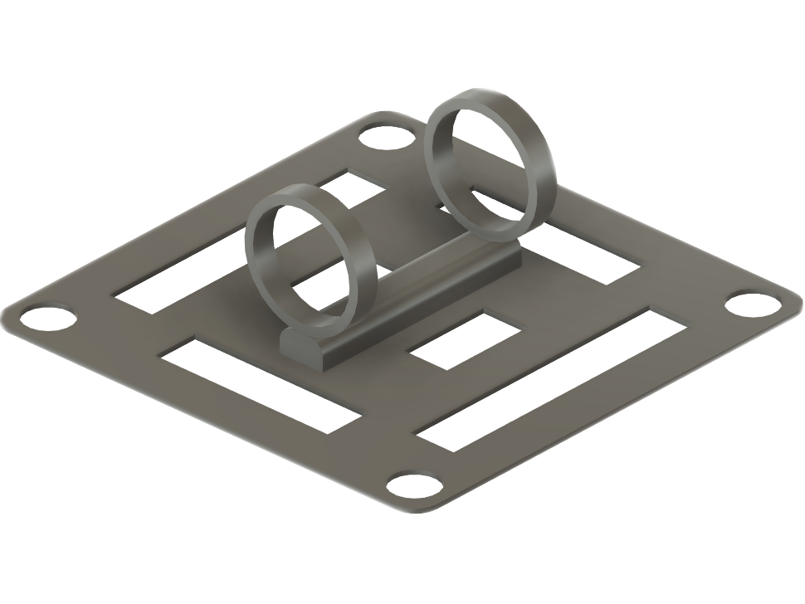
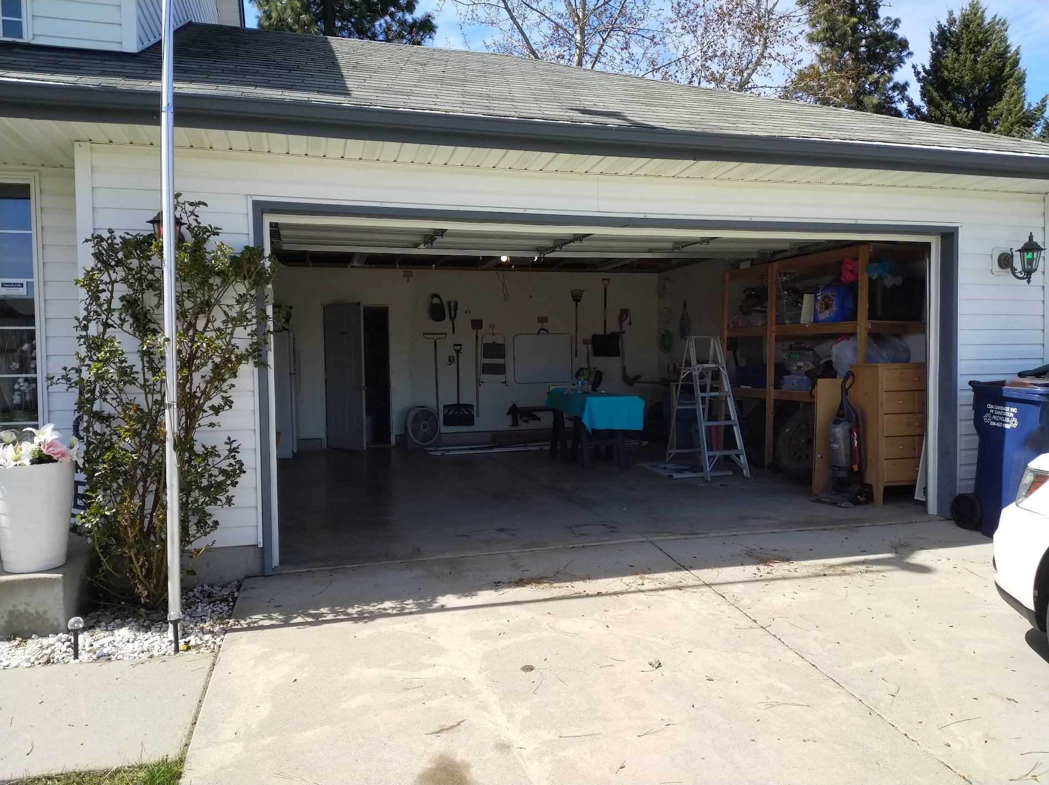
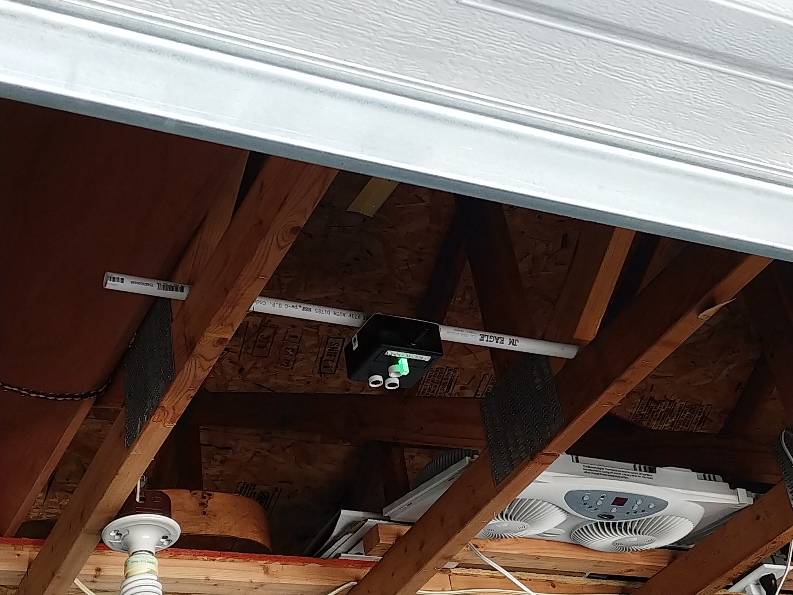
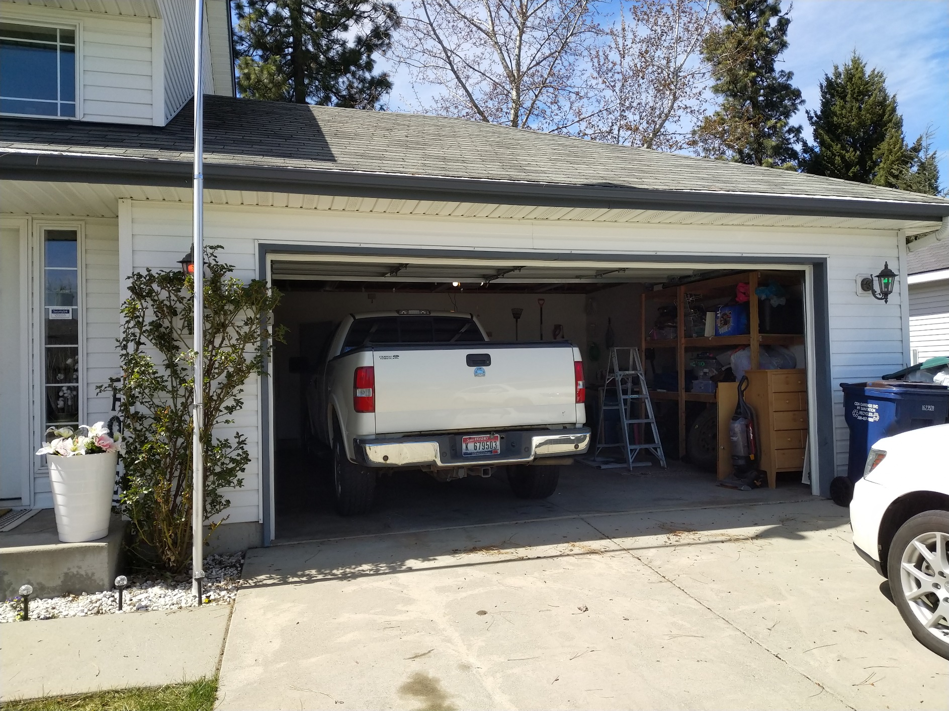
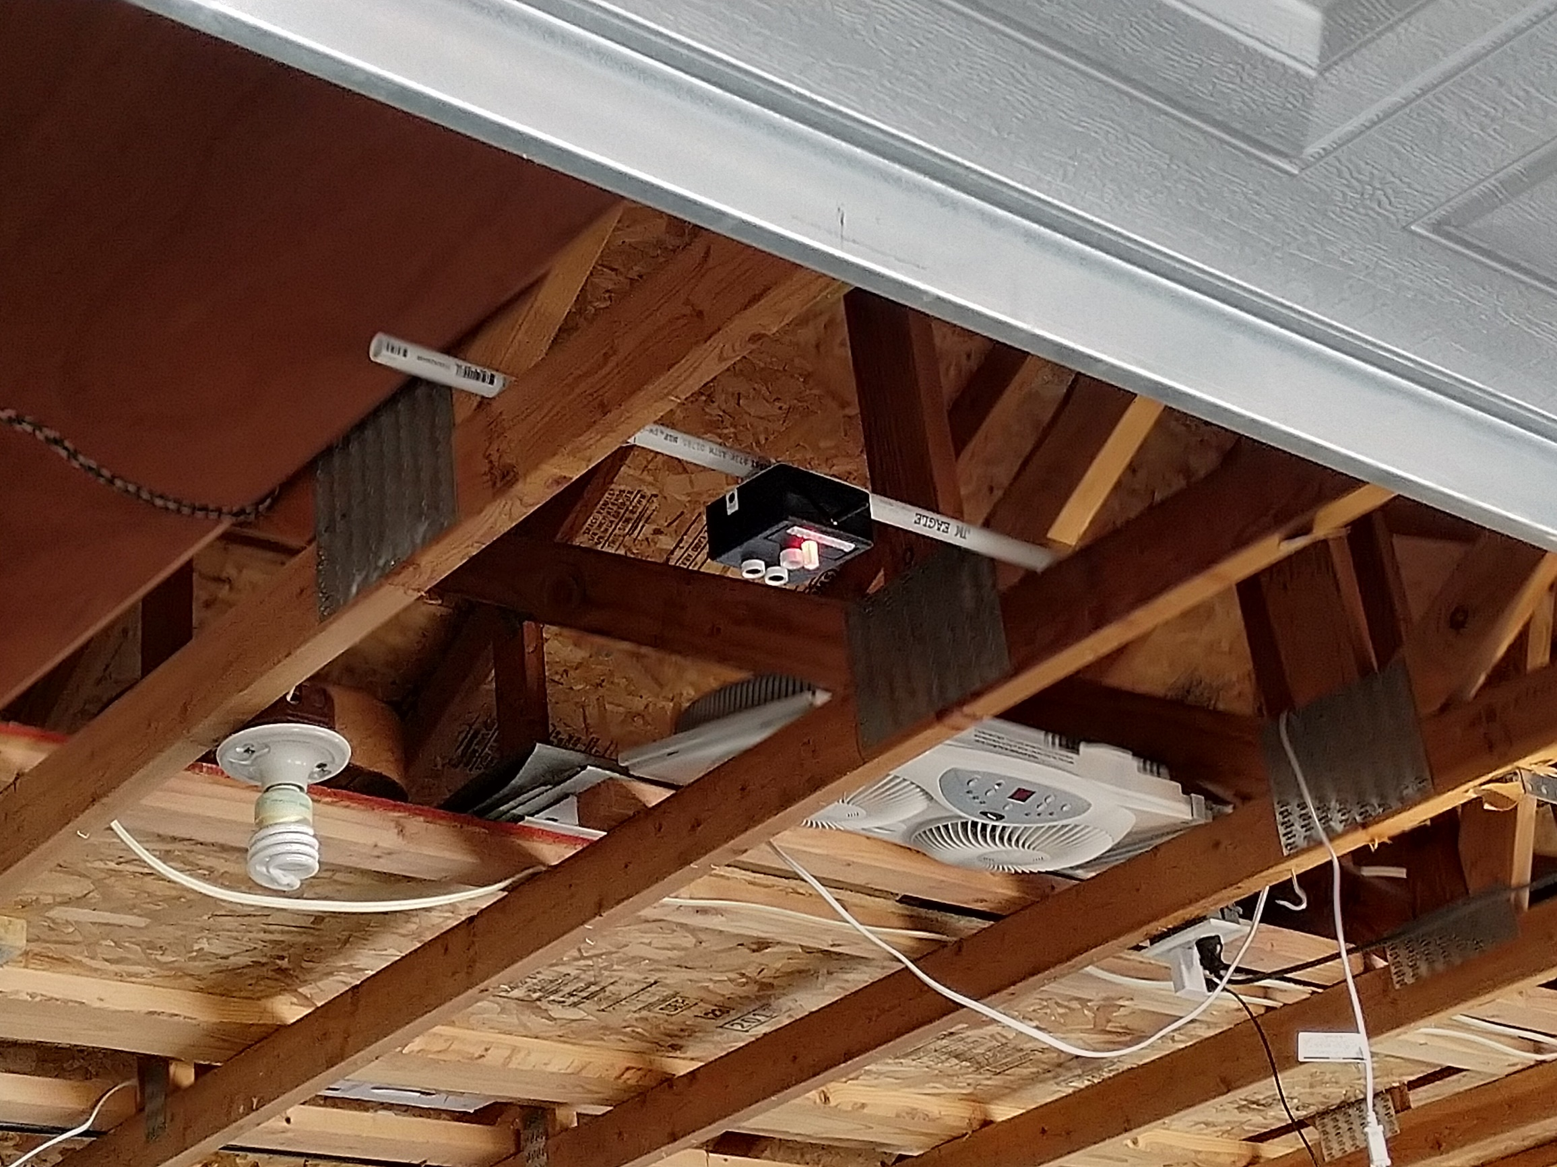
Sensing vehicles
Stay at home testing
- 3D printed PVC mount

Slide 10
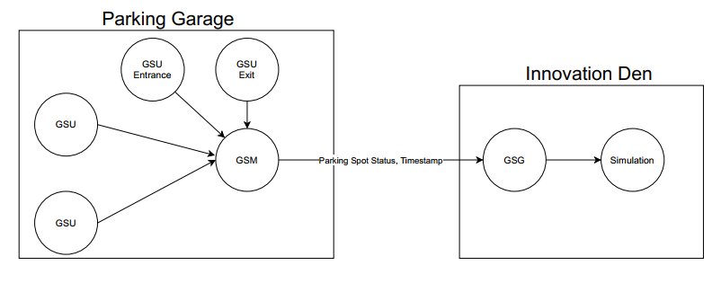
mesh networking
LoRa
LoRa (Long Range) was selected due to its ability to transmit over a long-range and low power usage
Create a mesh network where each of the 5 Garage Sensor Units (GSU) can communicate with one another, later changed to a star with one GSU a Garage Sensor Master (GSM)
The GSM would receive messages from the GSUs and then send data to the Garage Sensor Gateway (GSG) at the Innovation Den

Slide 11
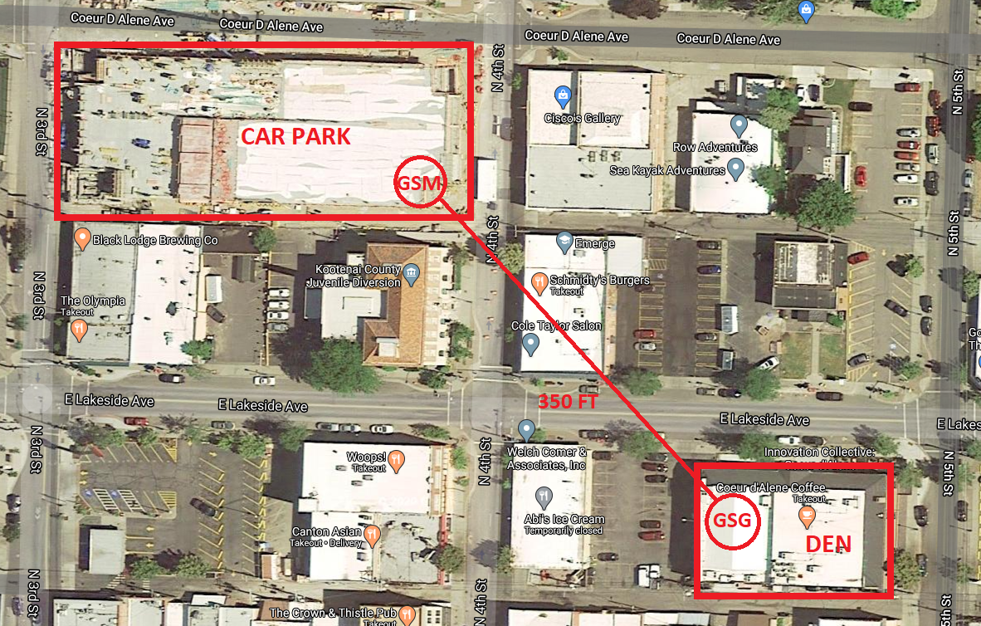
mesh networking
LoRa
Our testing revealed that we will be able to make the distance between the parking garage and the roof of the Innovation Den approx. 350 ft apart.

Slide 12
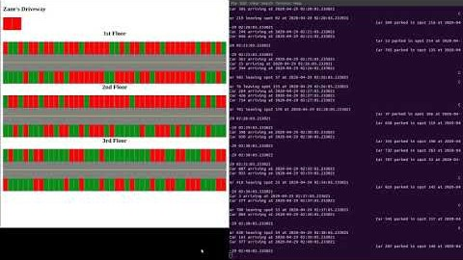
Tyrel Simulation

Slide 13
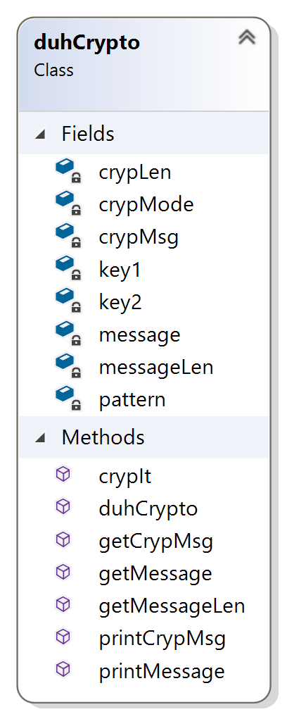



Encryption
Encryption
A class was created to send and receive crypted data throughout the network. This
class implements private key cryptography.
Two private keys and a predetermined pattern are used to encrypt and decrypt data
Encryption method
Methods to access or print the original and crypted data

Slide 14
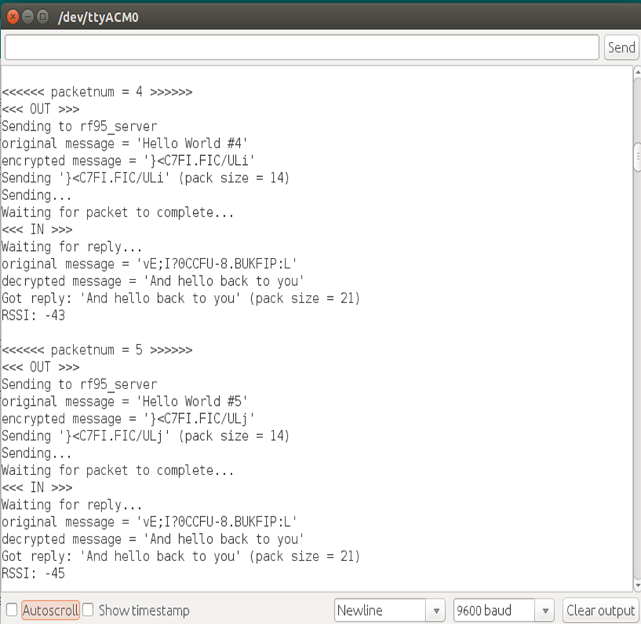
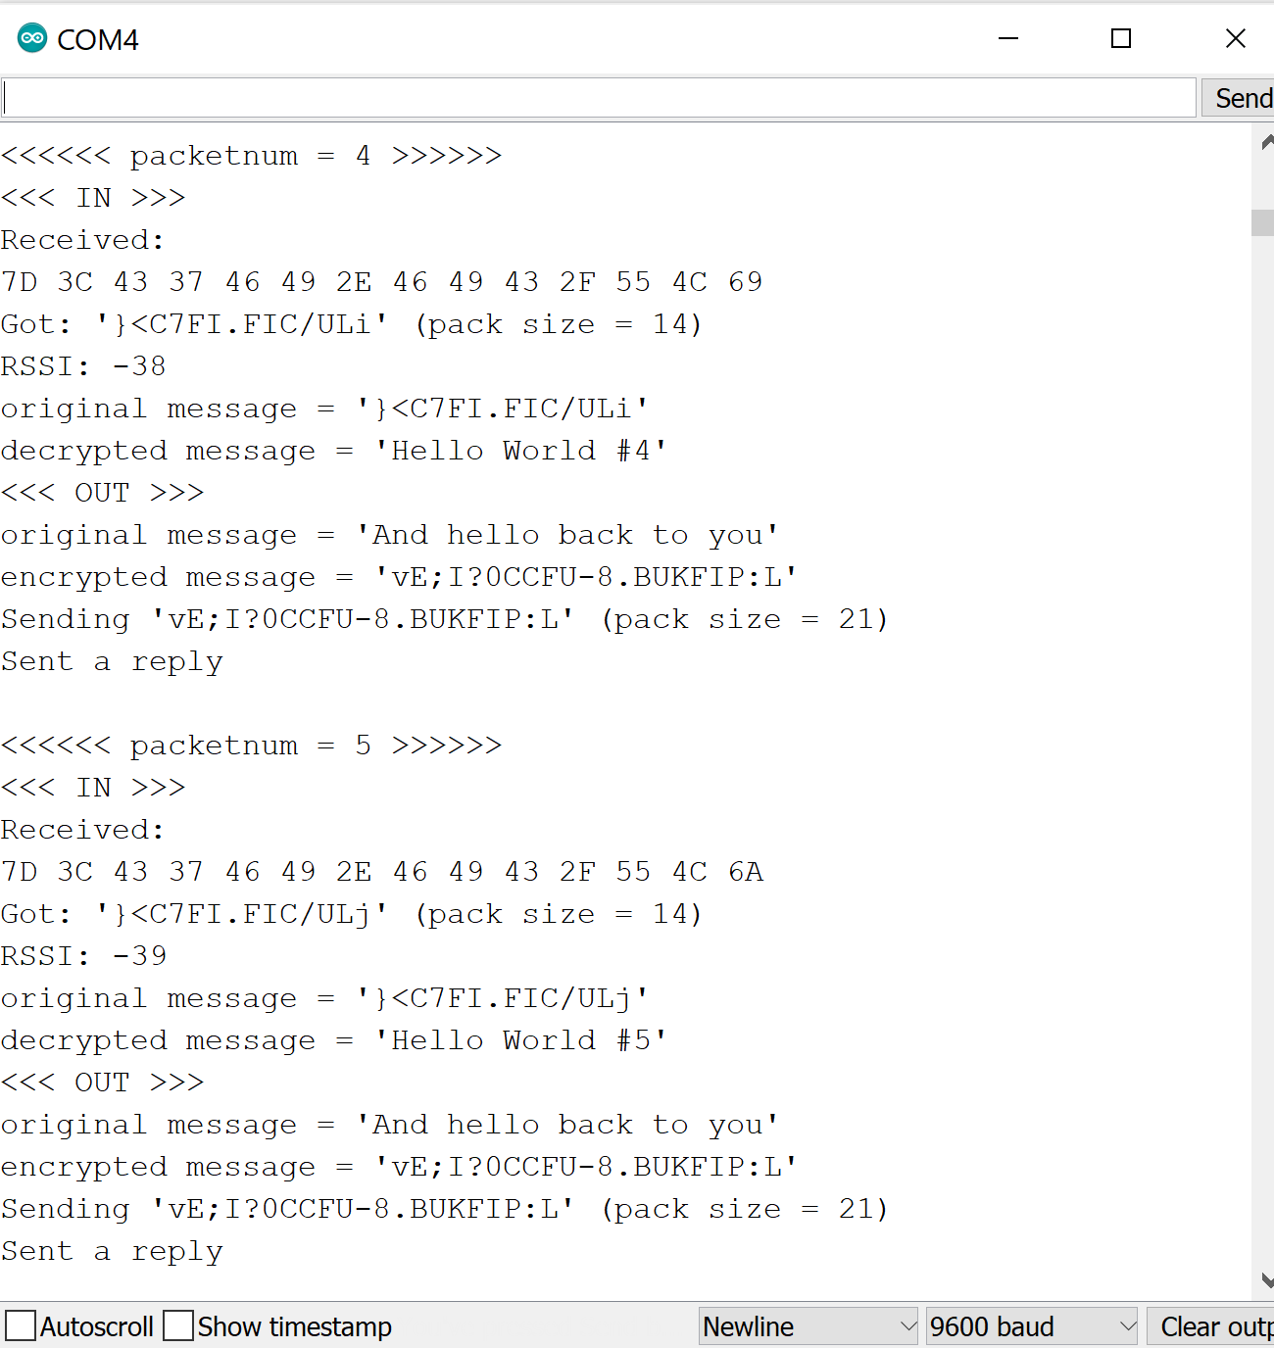


Encryption
(Example)
Client
Server

Slide 15
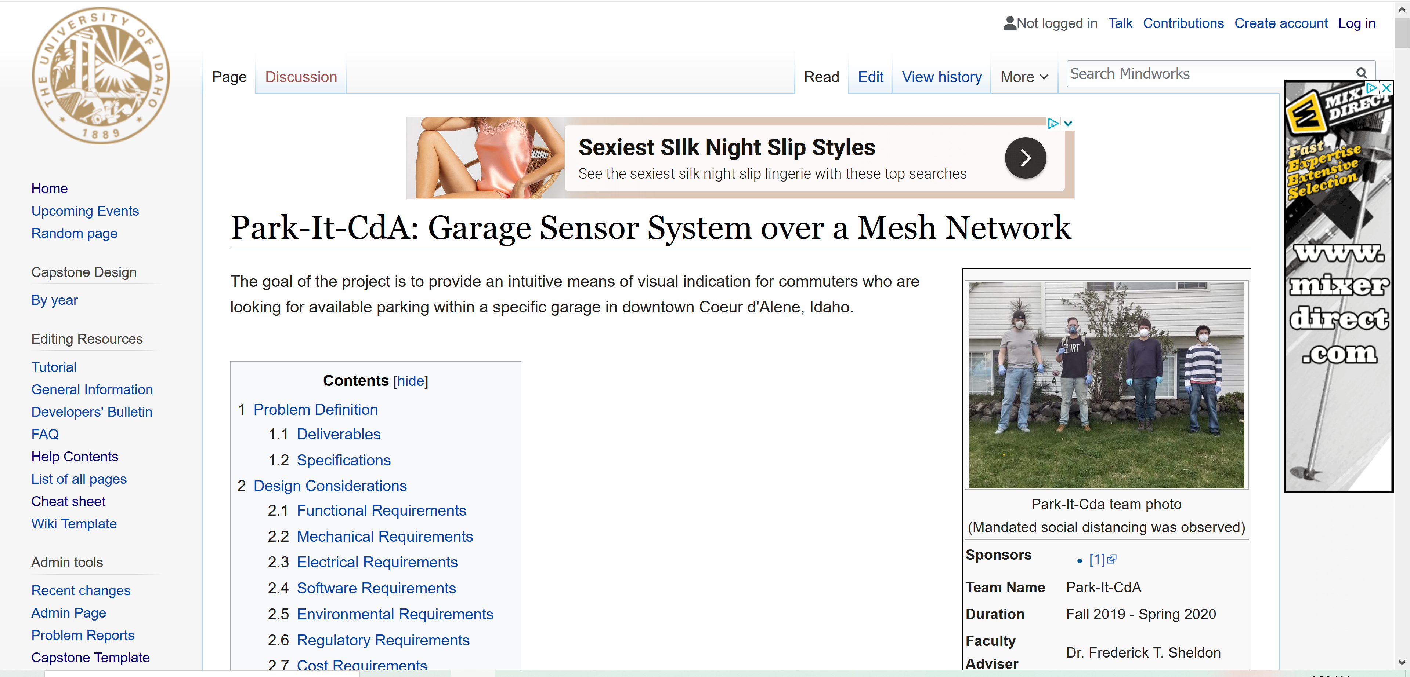
Wiki
Highlights the major components and the team’s lessons that were learned during the entire process
Provides more detail and additional documentation about our project
http://mindworks.shoutwiki.com/wiki/Park-It-CdA:_Garage_Sensor_System_over_a_Mesh_Network

Slide 16
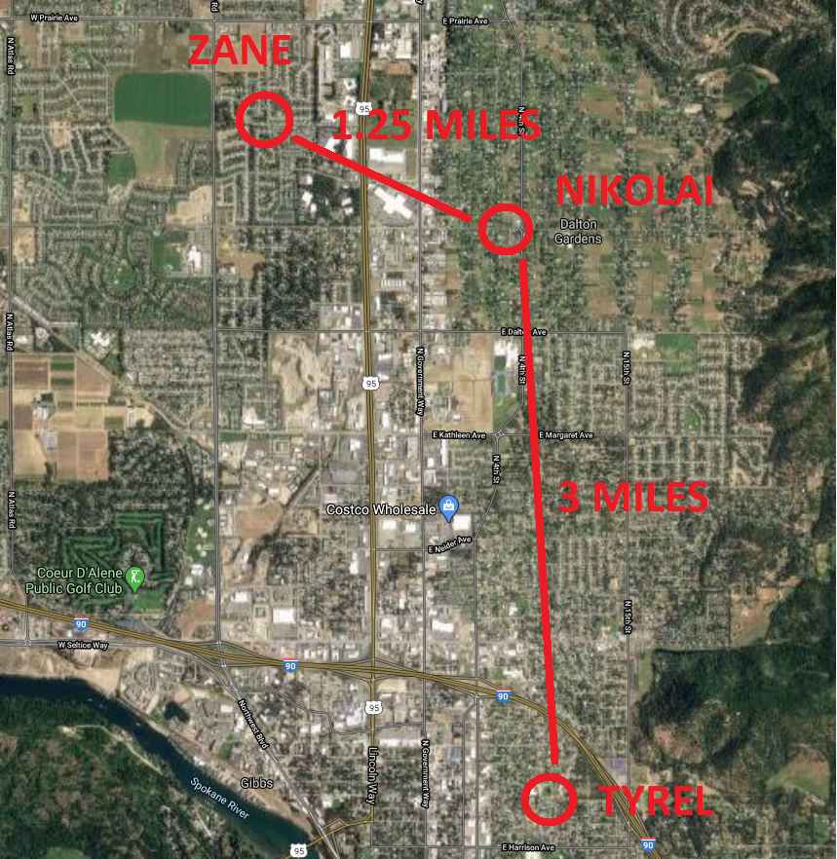
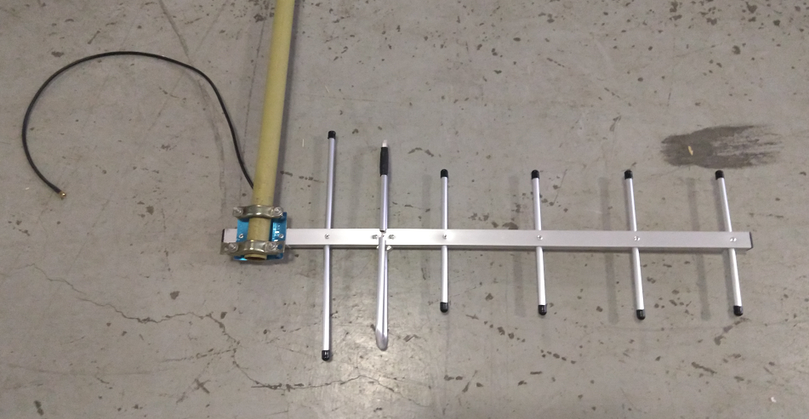
Covid-19 update
Our efforts to test and communicate while staying at home
We are a collaborative group, that could no longer be in the same location
We needed a way to communicate and test our units while remaining at home
Our sponsor, Dr. Shovic, gave us 2 long-range Yagi antennas
Nikolai and Zane, being the closest in proximity, started testing house-to-house communication

Slide 17
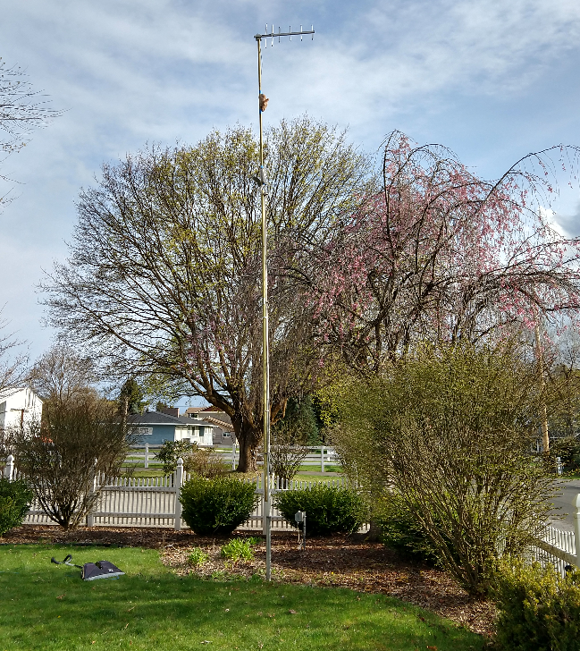
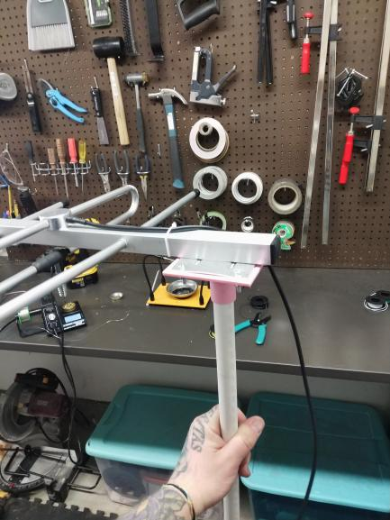

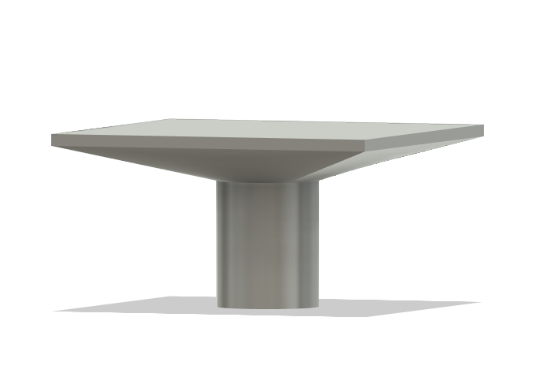
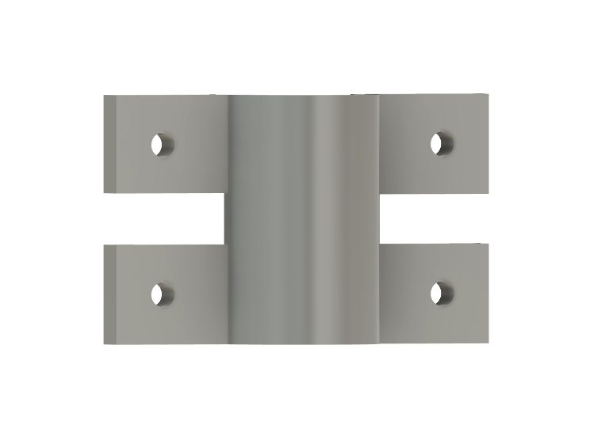
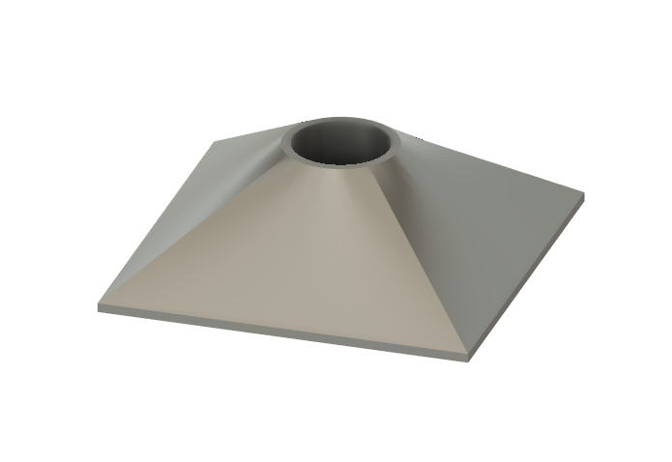
Testing long range
Makeshift masts and 3d printed hardware
Nikolai acquired a 20’ TV antenna, and turned it into a mast, attaching it to his flagpole
Zane designed some custom hardware for affixing a mast made from PVC to his roof

Slide 18
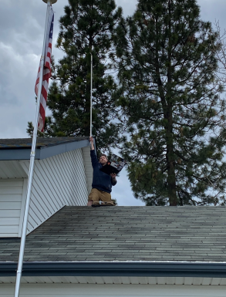
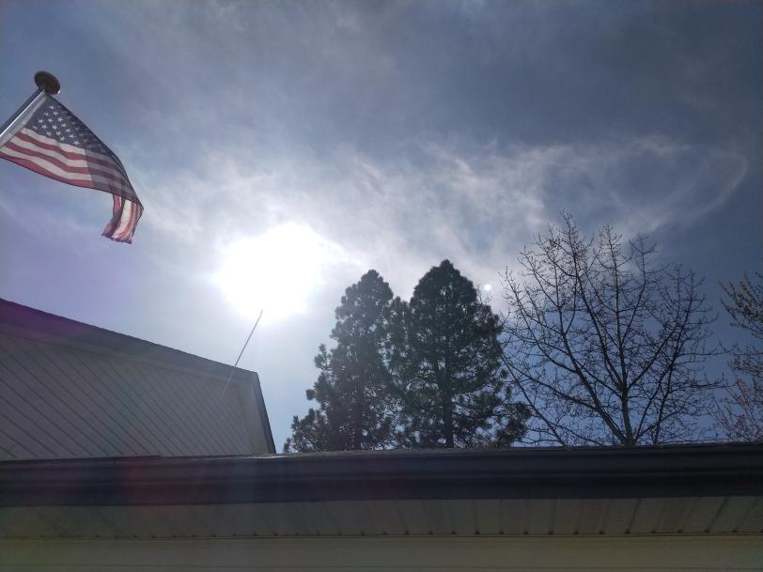
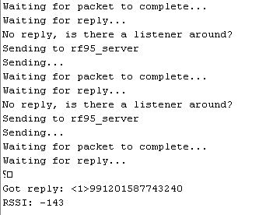
Successful transmissions
There were several successful transmissions made and received between both Zane and Nikolai
However, many more packets were lost than were received
In the end, the long-range communication just wasn’t stable and reliable enough for demonstration purposes

Slide 19
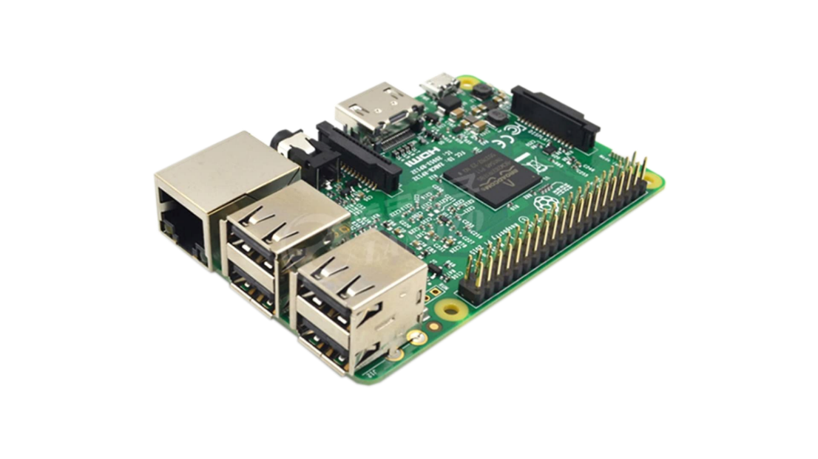
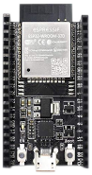
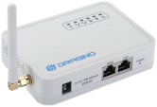
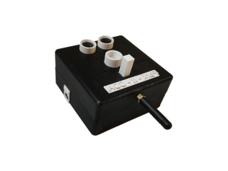
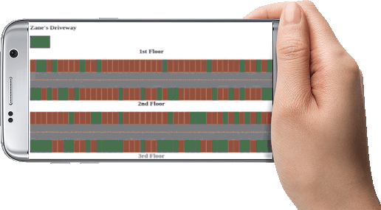
Final setup
Something more reliable
ESP32 hosts a dynamic webpage showing active units, simulation
- Units read stall status
Pi brokers MQTT topics and runs simulation; updates ESP32
Gateway receives packets, sends to Raspberry Pi at Tyrel’s house
- Units send stall status to gateway from Zane’s house
- Garage status can be viewed on mobile, tablet, PC

Slide 20
Conclusion
Thank you for watching
Here is a demo of the Park – It – CDA prototype in action:
Demo Video Link to go here
Approx. 1 minute long

Slide 21
Park – it - cda
Questions?
Nikolai Tiong
Tyrel Parker
Team leader
Mesh network
Simulation
Database
Zane Goodrick
Joel Berain
Unit Design
Sensor Prototyping
Encryption
Wiki Site
Instructor: Dr. Frederick Sheldon
Sponsor/customer: Dr. John Shovic

